Slide 1
Predicting Market Performance with @realDonaldTrump
Chen Zihang
Cheryl Koh Rou Rou
Vijayanarayanan Sai Arunavan

Slide 2
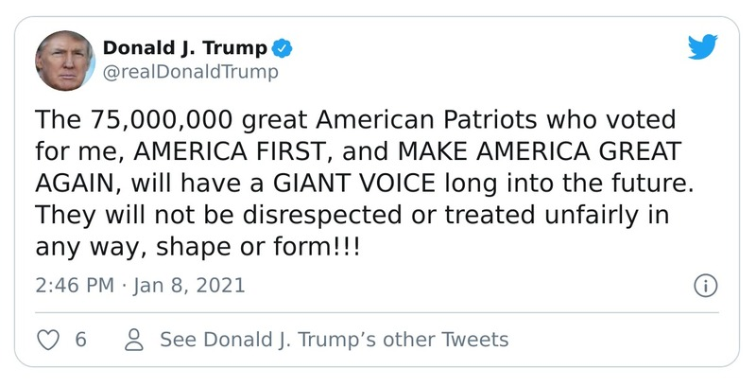
Problem Statement
“What were the impacts of Donald Trump’s Tweets, during his time of Presidency in the United States of America?”

Slide 3
Flow of content
Practical Motivation & Problem Formulation
Machine Learning
The motivation behind our project
Application of ML to tackle our problem
Data Acquisition &
Preparation
Evaluation
What we learned from this project and areas for improvement
Understanding and cleaning of datasets
Exploratory Data Analysis
Areas for Improvement
Exploration of relevant Datasets
What we could have included or expanded on

Slide 4
Practical Motivation
Twitter
As of the second quarter of 2021, Twitter had 206 million monetizable daily active users worldwide.
Donald Trump
Used the social media platform Twitter in a way that is unparalleled by any previous high ranking official.
S&P 500
Represents the performance of 500 large-cap companies listed on stock exchanges in the United States

Slide 5
Problem Formulation
Numeric Prediction
How might the content of Donald Trump’s Tweets influence the performance of S&P 500?

Slide 6
Data Collection
and Data Cleaning

Slide 7
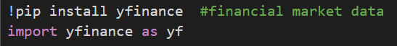
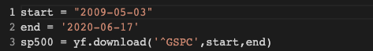
Data Collection
Donald Trump’s Tweets
Retrieved from https://www.kaggle.com/austinreese/trump-tweets
S&P 500 Data
Retrieved using yfinance library

Slide 8
Data Cleaning
Donald Trump’s Tweets
1
Removing unnecessary columns (such as “link” and “ID”)
Tweets Data
Cleaning
2
Splitting “date” column into “date” and “time” columns
3
Deleting rows where the content is a URL
Notes:
#removing column id and link as they do not provide any possibily insightful infromation
#splitting the date into date and time
#checking if a row's content only contained url
#deleting those within only urls as they do not provide any insight
#setting date to datetime data type
#setting date as the index

Slide 9
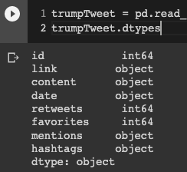
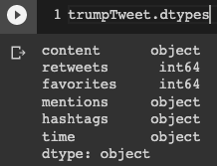
Data Cleaning
Donald Trump’s Tweets
Notes:
#removing column id and link as they do not provide any possibily insightful infromation
#splitting the date into date and time
#checking if a row's content only contained url
#deleting those within only urls as they do not provide any insight
#setting date to datetime data type
#setting date as the index

Slide 10
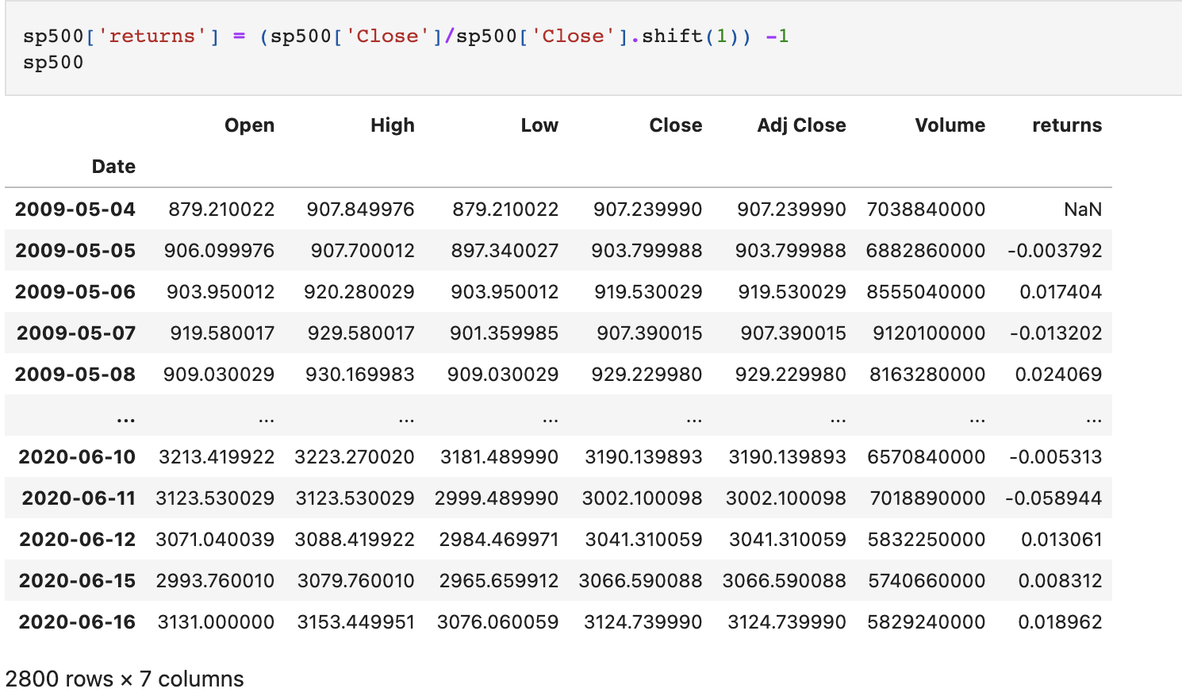
Data Cleaning
S&P 500 Data
S&P 500 Data
Cleaning
1
Added an additional column, ‘returns’
Notes:
#removing column id and link as they do not provide any possibily insightful infromation
#splitting the date into date and time
#checking if a row's content only contained url
#deleting those within only urls as they do not provide any insight
#setting date to datetime data type
#setting date as the index

Slide 11
Exploratory Data Analysis

Slide 12
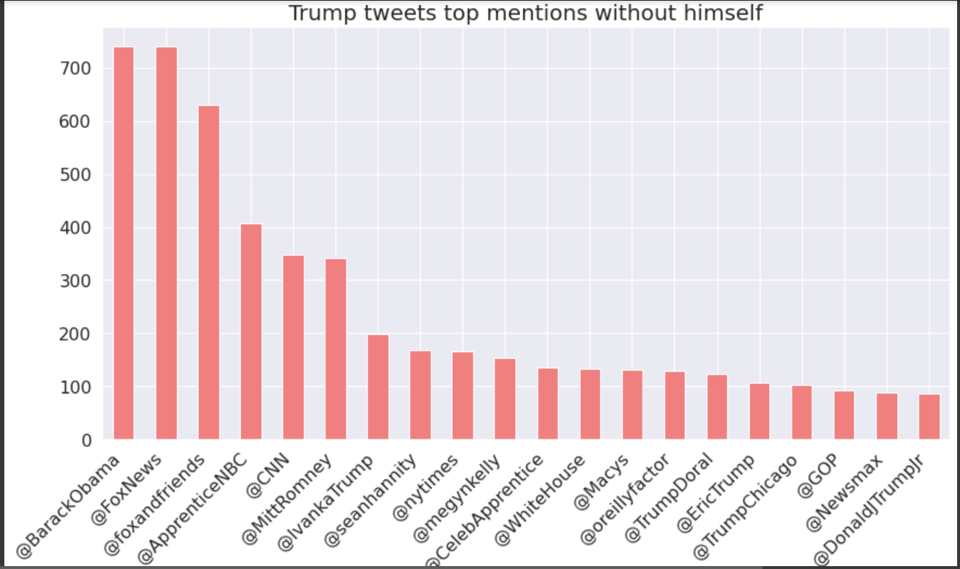
Exploratory Data Analysis
Donald Trump’s Tweets
Notes:
#removing column id and link as they do not provide any possibily insightful infromation
#splitting the date into date and time
#checking if a row's content only contained url
#deleting those within only urls as they do not provide any insight
#setting date to datetime data type
#setting date as the index

Slide 13
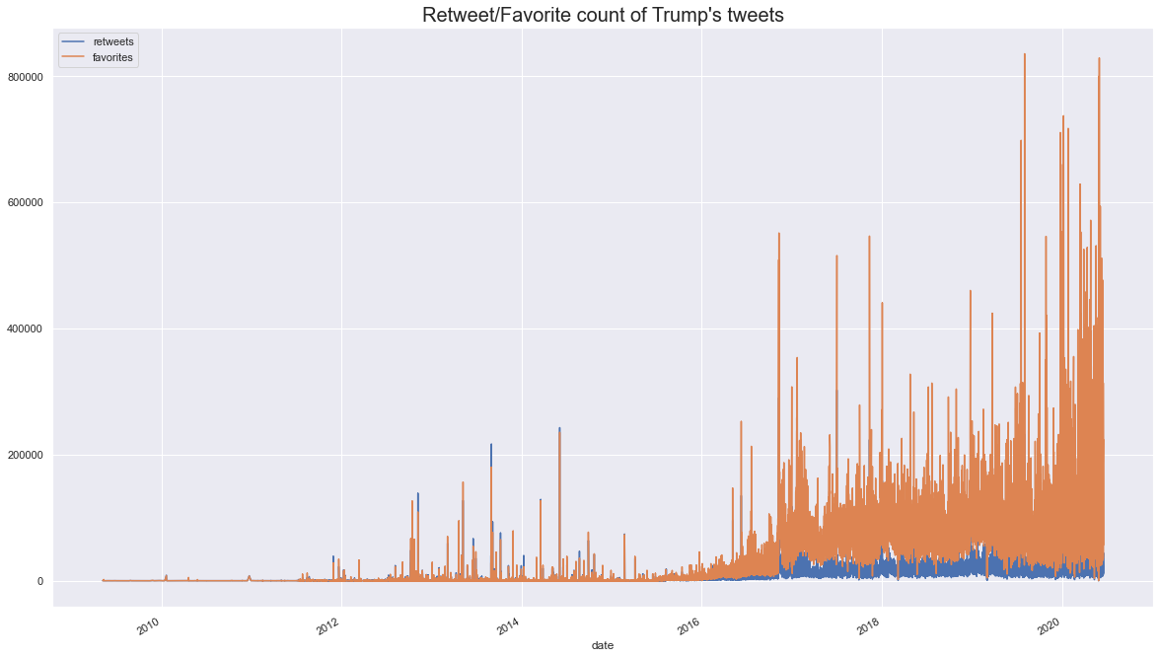
Exploratory Data Analysis
Donald Trump’s Tweets
The number of retweets/favourites is very volatile, making it difficult to see a trend. We decided to use average in 100 days to better see a trend in the counts.
Notes:
#removing column id and link as they do not provide any possibily insightful infromation
#splitting the date into date and time
#checking if a row's content only contained url
#deleting those within only urls as they do not provide any insight
#setting date to datetime data type
#setting date as the index

Slide 14
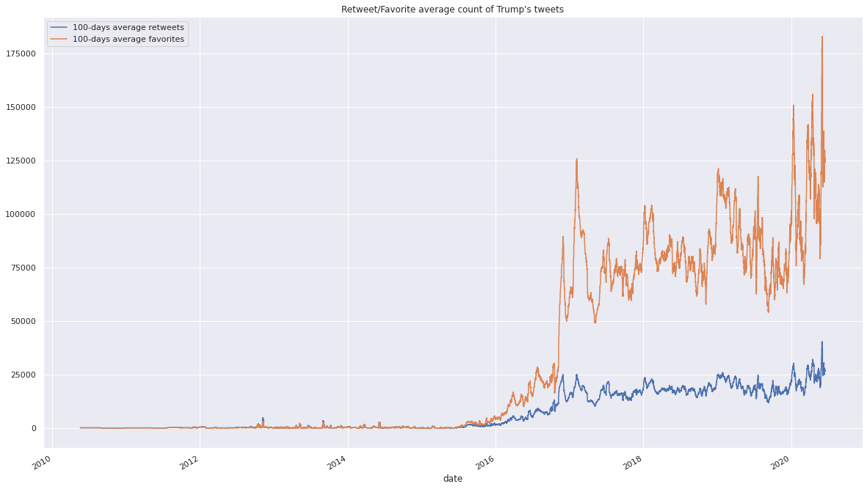
Exploratory Data Analysis
Donald Trump’s Tweets
The number of retweets/favourites is very volatile, making it difficult to see a trend. We decided to use average in 100 days to better see a trend in the counts.
Sharp increase of retweets and favourites after winning the
2016 presidential elections
Notes:
#removing column id and link as they do not provide any possibily insightful infromation
#splitting the date into date and time
#checking if a row's content only contained url
#deleting those within only urls as they do not provide any insight
#setting date to datetime data type
#setting date as the index

Slide 15
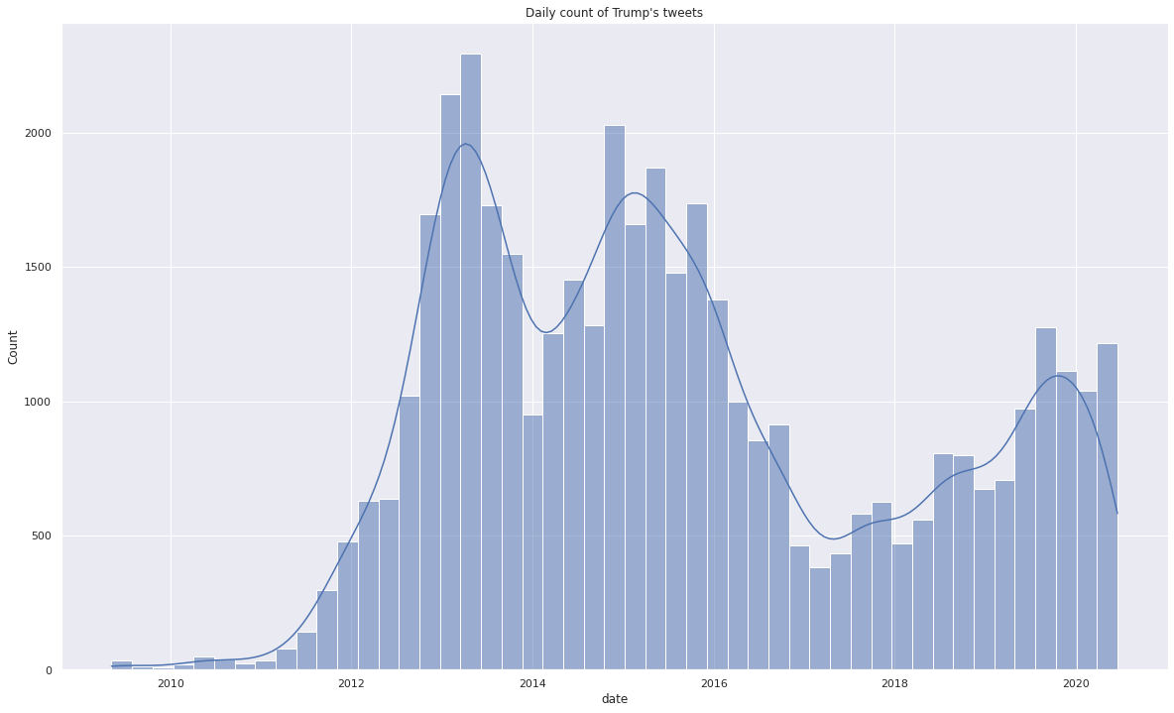
Exploratory Data Analysis
Donald Trump’s Tweets
Daily count of tweets gradually rose
Notes:
#removing column id and link as they do not provide any possibily insightful infromation
#splitting the date into date and time
#checking if a row's content only contained url
#deleting those within only urls as they do not provide any insight
#setting date to datetime data type
#setting date as the index

Slide 16
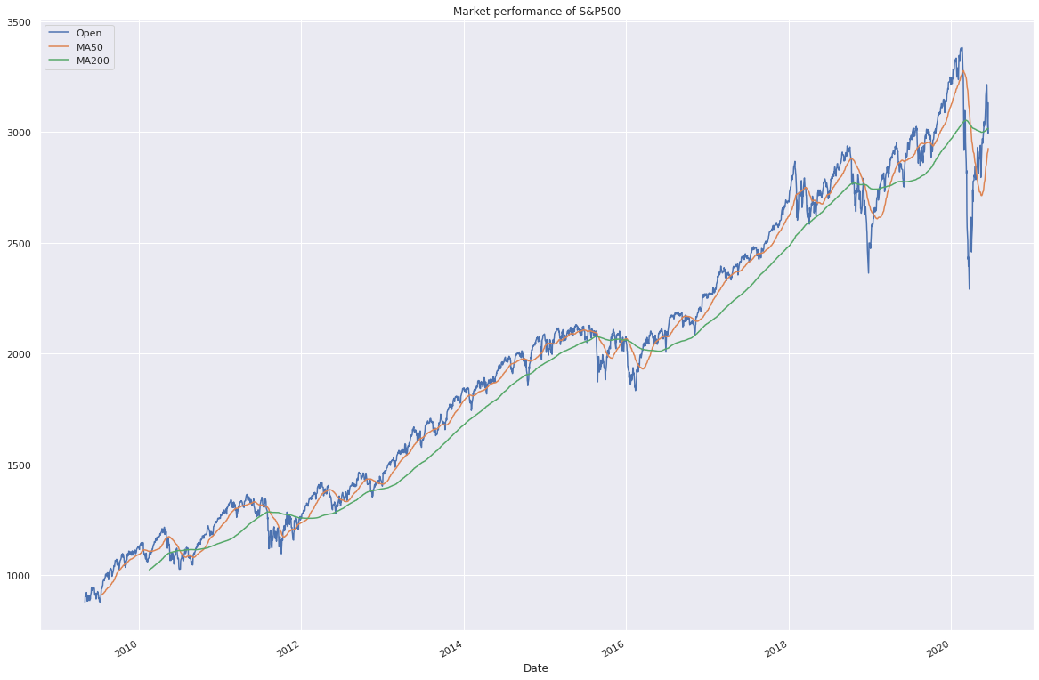
Exploratory Data Analysis
S&P 500
Daily count of tweets gradually rose
Sharp decline due to Covid-19
Notes:
#removing column id and link as they do not provide any possibily insightful infromation
#splitting the date into date and time
#checking if a row's content only contained url
#deleting those within only urls as they do not provide any insight
#setting date to datetime data type
#setting date as the index

Slide 17
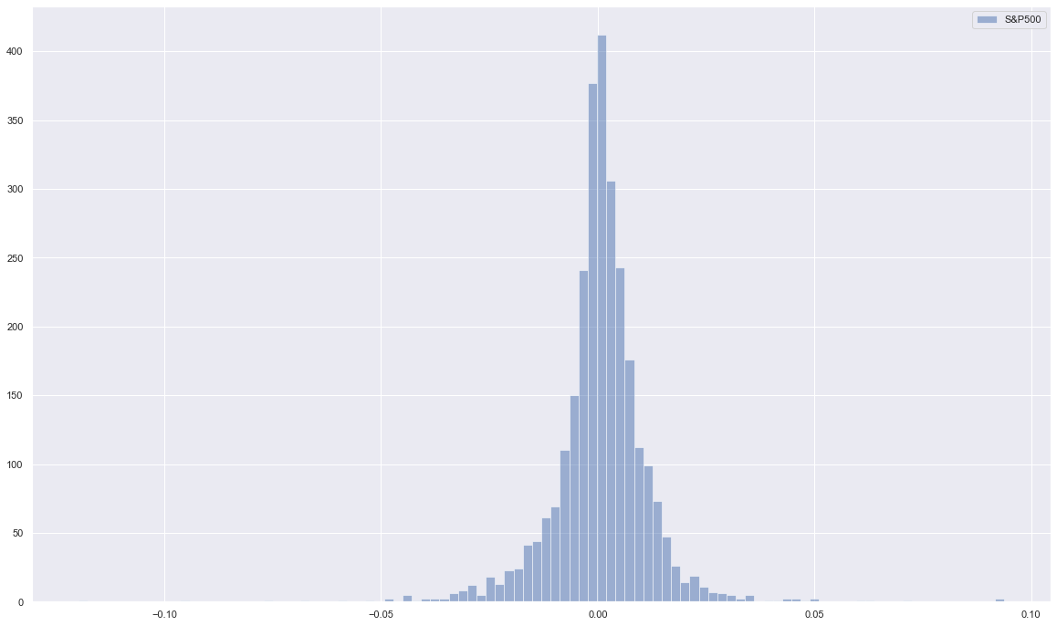
Exploratory Data Analysis
S&P 500
Notes:
#removing column id and link as they do not provide any possibily insightful infromation
#splitting the date into date and time
#checking if a row's content only contained url
#deleting those within only urls as they do not provide any insight
#setting date to datetime data type
#setting date as the index

Slide 18
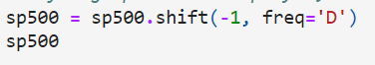
Combining Datasets
Shift the dates of S&P 500 up by one day
Move tweets posted near or after closing time to the following day
Dropped rows where stock market is closed

Slide 19
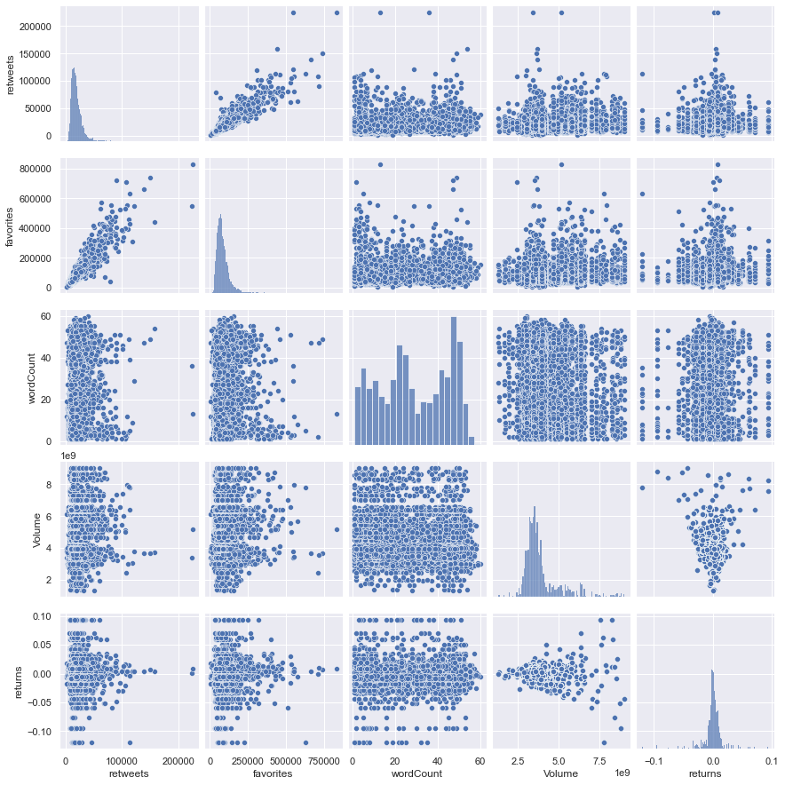
Exploratory Data Analysis
Combined
Notes:
#removing column id and link as they do not provide any possibily insightful infromation
#splitting the date into date and time
#checking if a row's content only contained url
#deleting those within only urls as they do not provide any insight
#setting date to datetime data type
#setting date as the index

Slide 20
Machine Learning
Notes:
next, we’ll be moving onto machine learning.

Slide 21
Machine Learning
Linear Regression
To predict market performance with most commonly used words by Donald Trump, excluding stop words.
To predict market performance with the topics related to by the tweet of Donald Trump
Notes:
To find out if there exist any causal relationship between Donald Trump’s Tweets and the market performance of s&p500 on the following day, we used linear regression in two ways. Firstly by assessing the presence of certain words in his tweet and secondly, by the topics that his tweet is related to. The former is easy, however, for the latter, we will need to generate topics using natural language processing that was not covered in the course.

Slide 22
Machine Learning
Natural Language Processing
Text
Pre-Processing
Latent Dirichlet Allocation
Tokenization
N-grams
Stop Words Filtering
Stemming
Dictionary
Corpus
LDA Modeling
Perplexity & Coherence Score
Topic Visualisation
Notes:
Textual data available in natural language form is not suitable for use with data mining techniques. Natural language contains words that are inflected, i.e. words expressed in distinct grammatical terms. In order to produce representative insight from the text data, we need to use techniques and principles from text mining and natural language processing (NLP).
There are two main steps of NLP that we applied in our project. Firstly, (click) text pre-processing, followed (click) by application of the Latent Dirichlet(duh-ri-klet) allocation model to generate the topics with word clouds.

Slide 23
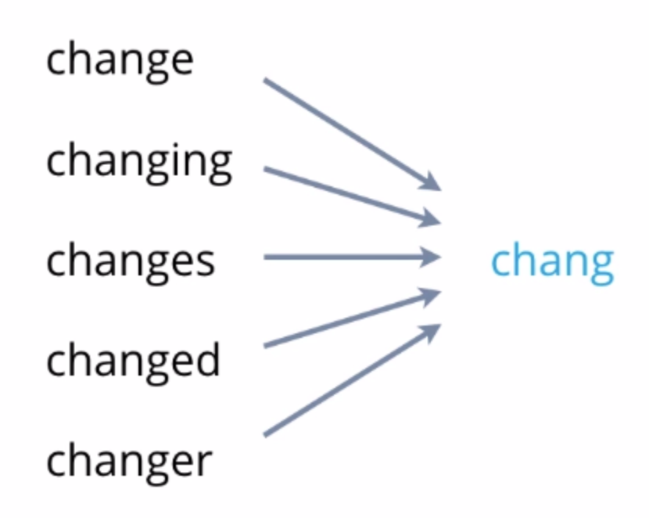
Machine Learning
Text Pre-Processing
Stemming
Notes:
One interesting step we will like to point out is stemming. Words come in different forms, and stemming is a text normalisation technique used to reduce the inflection in words and makes it possible to map a collection of words to the identical root.

Slide 24
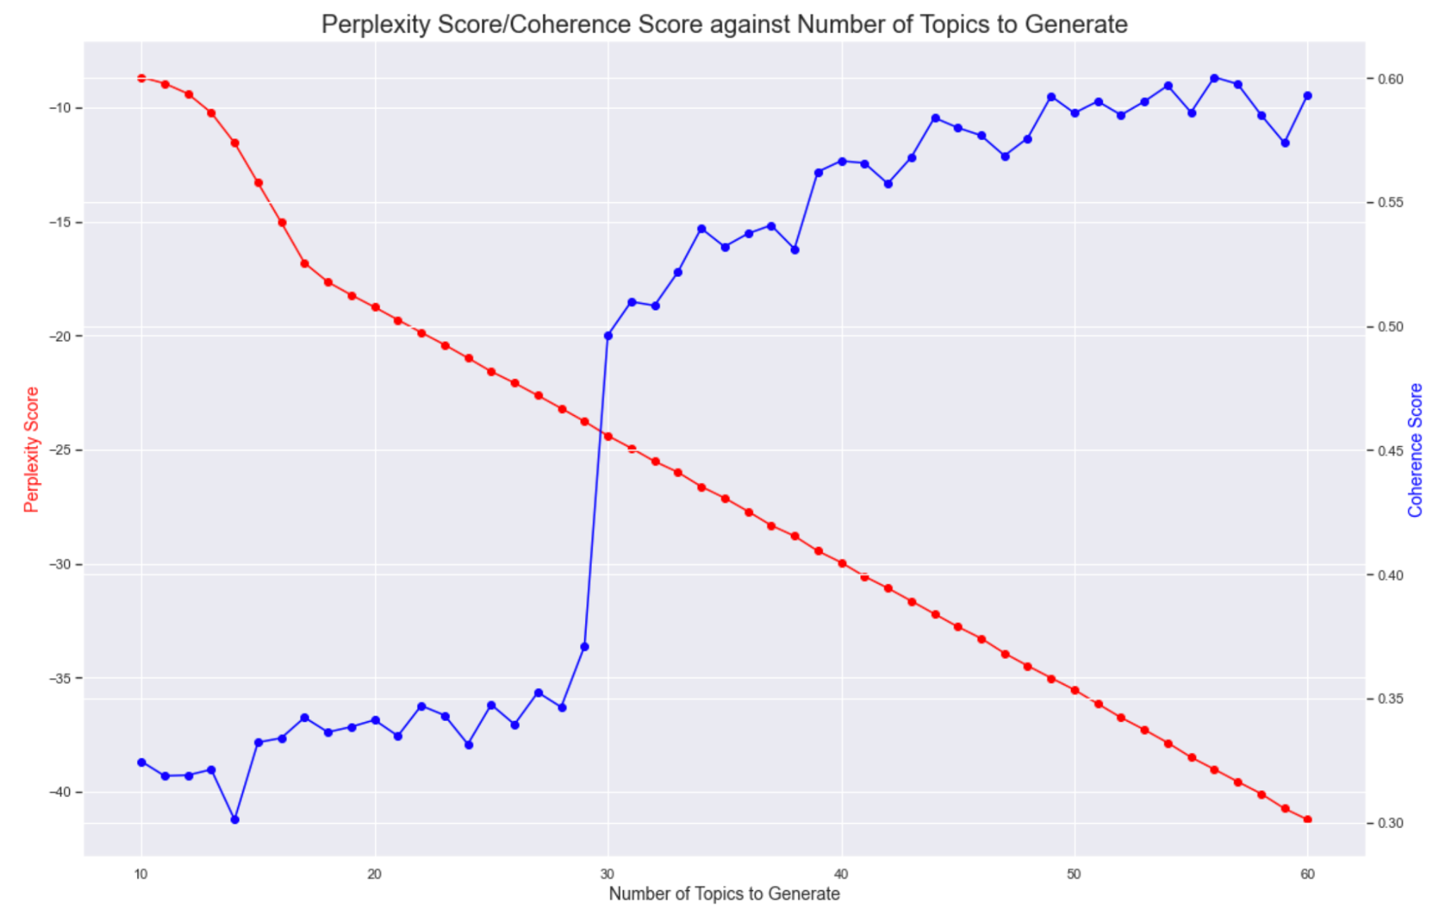
Machine Learning
Latent Dirichlet Allocation
Perplexity & Coherence Score
Notes:
These were then inputted to generate LDA models and topics. The LDA model does not inform us what the number of topics of a corpus should be. A necessary input of building our LDA model is, therefore, the number of topics, K.
topic coherence score is a measure of how well separated the topics are, the higher the better and perplexity score is a measure of how good the model is which is the lower the better.Our LDA model was run for different values of K and the scores were calculated for each iteration. A graph of scores for different k value is plotted.
As we want the number of topics to be few enough to have distinct semantic interpretations, we (click) chose a k value between 30/40 despite higher k shows higher coherence score and lower perplexity score.

Slide 25
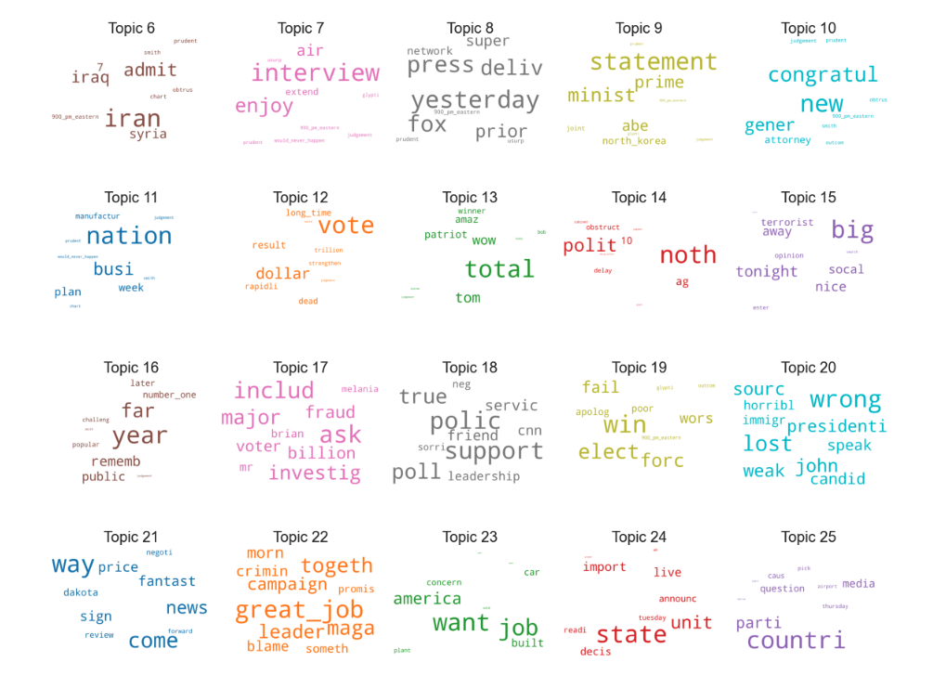
Machine Learning
Latent Dirichlet Allocation
Topics generated
Notes:
Here’s what we generated. Some interesting topics includes Trump’s favorite fake news and media outlets, and some revolved around war in iraq and iran.

Slide 26
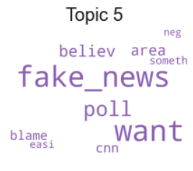
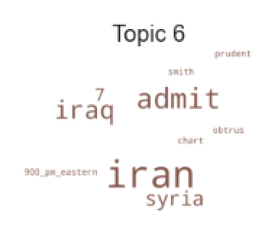
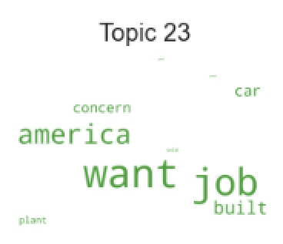
Machine Learning
Latent Dirichlet Allocation
Topics generated
Notes:
Here’s what we generated. Some interesting topics includes Trump’s favorite fake news and media outlets, and some revolved around war in iraq and iran.

Slide 27
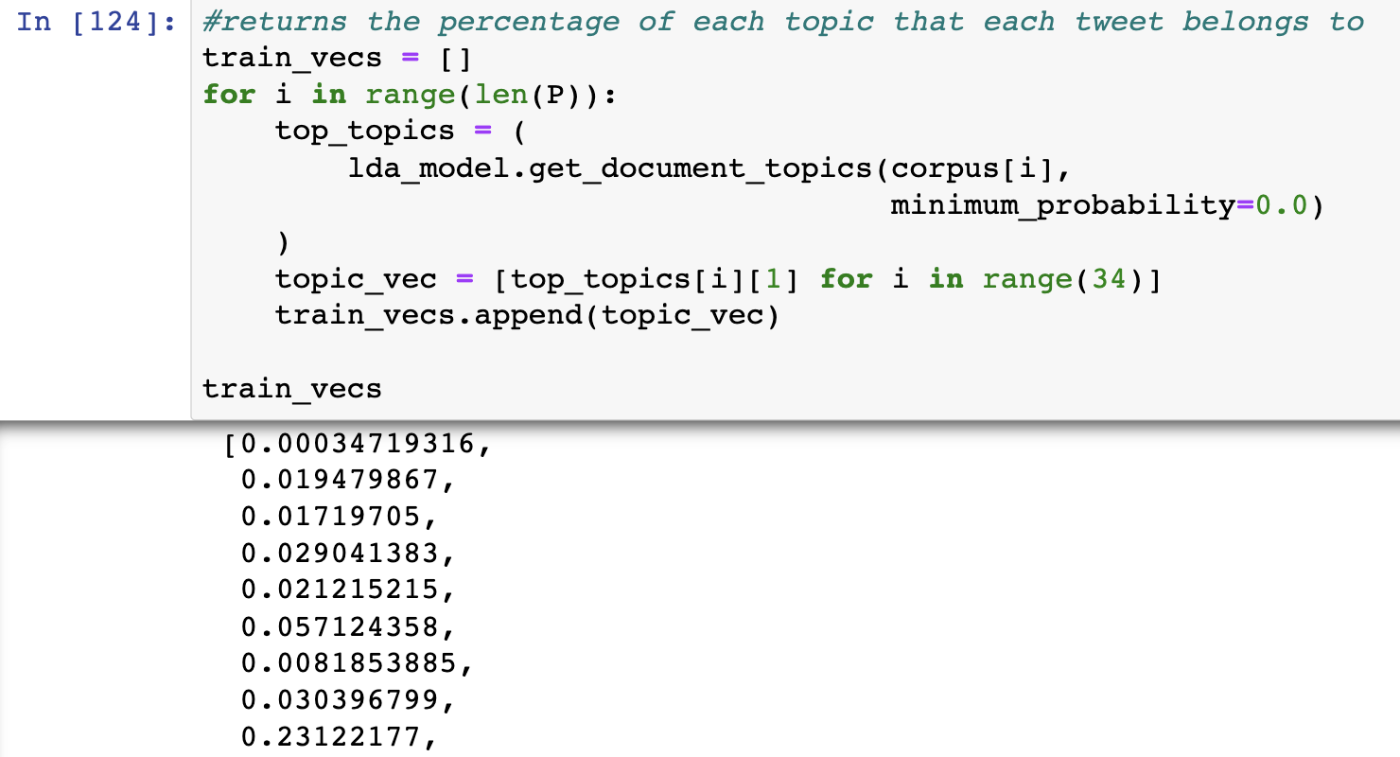
Machine Learning
Latent Dirichlet Allocation
Converting Topics to Feature Vectors
Notes:
We then utilise these topics generated to categories each tweet to different topics. Here we used supervised classification using topic model vectors to generate the distribution of each topics for every tweet. For example, this tweet is made up of……. We then choose the top 3 topics and assign their numbers to the tweet.

Slide 28
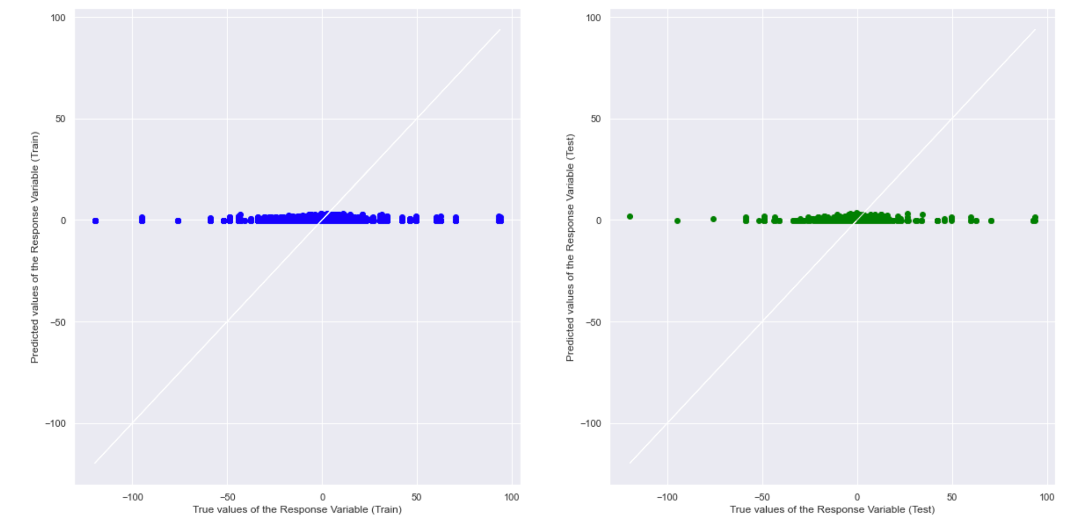
Machine Learning
Multivariate Linear Regression
Top 3 topic numbers as numerical data
Presence of certain words (1/0) as categorical data
Notes:
Linear regressions is then utilised, either using categorical data that represent the presence of certain words, or with the numbers of the top 3 relatable topics. To our dismay, no concrete relationship could be identified.

Slide 29
Evaluation
Notes:
Through the above processes, we have concluded that there is no discernible relationship between the content of Donald Trump’s tweets and the performance of the S&P 500 the following day. However, it may also be our lack of knowledge on more suitable prediction models and inefficient use of natural language processing. Afterall this was our first attempt in urilising natural language processing.

Slide 30

Evaluation
@realDonaldTrump:
Unemployment rate is low because US is blessed with the greatest president ever!!
#MakeAmericaGreatAgain
Notes:
Thinking back, we realise that It is very problematic to interpret correlation between daily price changes and Trump's tweets during that day in a causal way due to omitted variable problem. Consider the following example: New US unemployment rate is published, and it is much lower than expected. (click) Stock market goes up, and Donald Trump posts a tweet (click) that he is a great president and because of him, unemployment went down. Therefore, even if we observe a association between Trump's tweets and financial markets in daily data, this association may be caused by both financial markets and Donald Trump responding to same news. Thus, causality cannot be established.
Furthermore, there might be a certain degree of influence of Trump’s tweet on the market, but were rather small or mitgated by actions of other influential traders.

Slide 31

Evaluation
New tweet from @realDonaldTrump
2 min 5 min 10 min 20 min
Notes:
Hence we think that it may have been more ideal if we were to utilize high-frequency financial data together with exact time stamps of Trump's tweets. (click) This setup will allow us to directly observe what happens to financial markets right after President Trump published his tweet. (click) These results directly answer whether Trump's tweets influence financial markets, because it is unlikely that Donald Trump is responding to news faster than high-frequency traders.

Slide 32
Thank you
Notes:
Hence we think that it may have been more ideal if we were to utilize high-frequency financial data together with exact time stamps of Trump's tweets. (click) This setup will allow us to directly observe what happens to financial markets right after President Trump published his tweet. (click) These results directly answer whether Trump's tweets influence financial markets, because it is unlikely that Donald Trump is responding to news faster than high-frequency traders.

